Slide 1


Student Result List
Name: Fariha Naeem
Roll No: 19SW13
Subject: Data Structures and Algorithms
Presented to: Sir Mohsin Ali Memon

Slide 2

Problem to be solved using Data Structure:
We have certain credentials of no: of students (i.e: Name, roll number, Subject marks, total marks, percentage etc)
It’s really difficult to tell each student separately his/her result.
So what we want to do here is to create a list containing every student’s record.
Each Student record in a single row.
Students should be able to search their results using roll numbers from the list.
We don’t need to add records b/w some records.
Notes:
The problem that I chose to be solved using data structures is that we have students some details like name roll no:, subject marks, marks, percentage etc and we want to create a list containing all these credentials together. We don’t want to manipulate records. All we want to do is add records at the end or remove records from the end.

Slide 3
Use of Data Structure in the above Problem:
ArrayList Vs LinkedList:
The LinkedList class is a collection which can contain many objects of the same type, just like the ArrayList.
The LinkedList class has all of the same methods as the ArrayList class because they both implement the List interface. This means that you can add items, change items, remove items and clear the list in the same way.
However, while the ArrayList class and the LinkedList class can be used in the same way, they are built very differently.
Notes:
To solve the given scenario, We can think to use LinkedList or ArrayList because they both implement List interface.
Using these classes, we can perform certain actions like add, remove, update and clear.

Slide 4
Continue..
Working:
It is best to use an ArrayList when:
You want to access random items frequently
You only need to add or remove elements at the end of the list
It is best to use a LinkedList when:
You only use the list by looping through it instead of accessing random items
You frequently need to add and remove items from the beginning, middle or end of the list.
Notes:
We all know that LinkedList is a good choice when we want to manipulate data. Means When we want to add some record at the particular position. Or when we want to remove data from the particular location.
While ArrayList is a best bet when we want to search some record from the List because in ArrayList searching is very easy and Quick operation.
We can also go for HashTables or Hashaps But most students found it difficult in comparison of LinkedList and ArrayList.
So I picked ArrayList since we only want search operation and not manipulation of data.

Slide 5

Title
Text
Notes:
Like in this list, students are not sorted by cpn or marks but they are just placed based on district. So in my project, I also saved some student records of same school randomly and display them in the form of list.

Slide 6
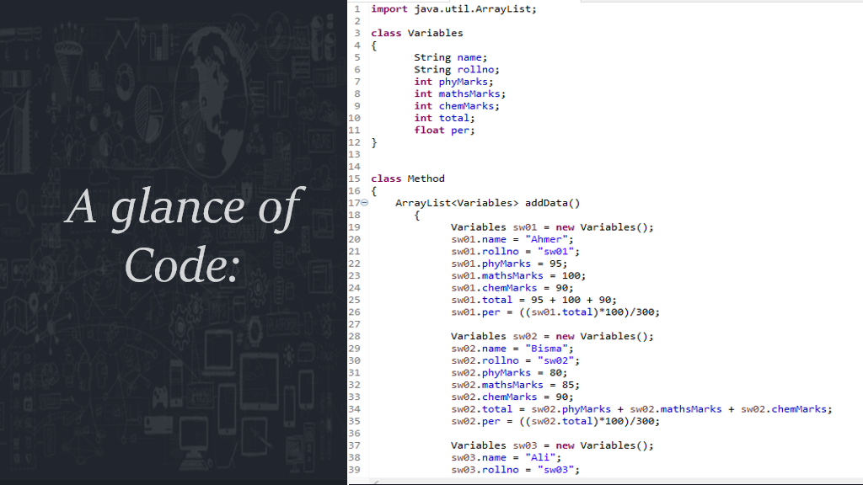
Title
Text
Notes:
Here Class variables is a class that contains declaration of student credentials. Next I have used Generic method of class Variables named AddData() with no arguments. In this method I have stored students data. We can also ask users to enter data.

Slide 7
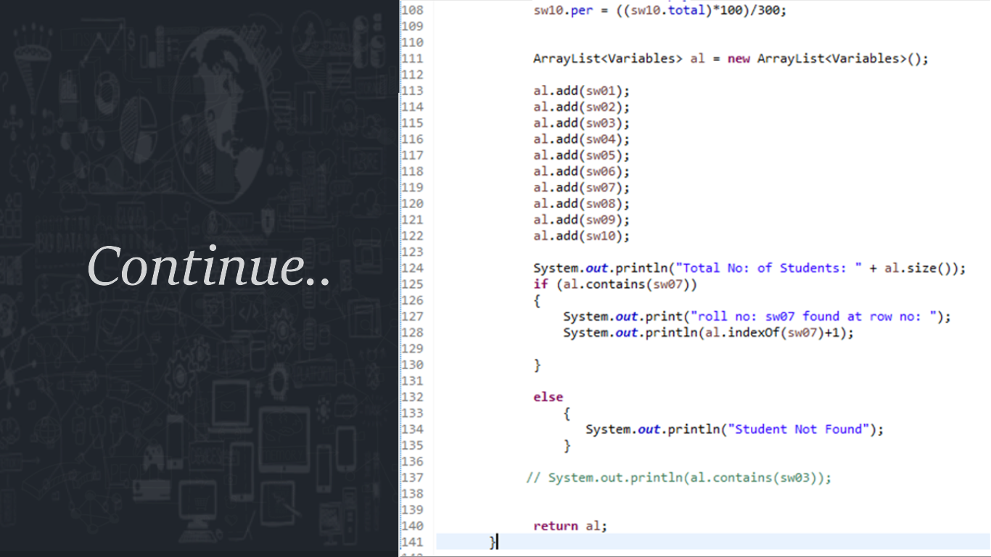
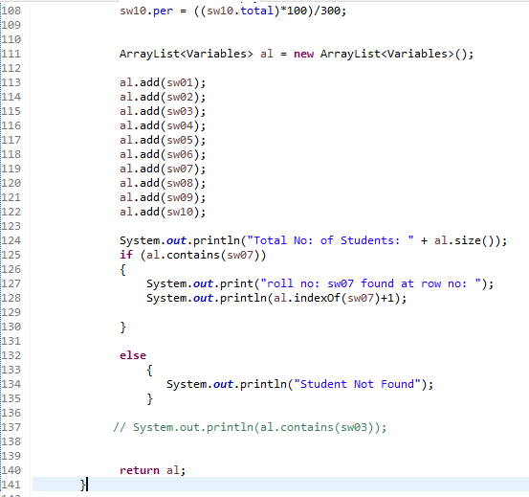
Title
Text
Notes:
Inside this method I have created object of class ArrayList. Using which I accessed the predefined function named add() function. I have also used some other predefined functions like contains function, indexOf, and size function.

Slide 8
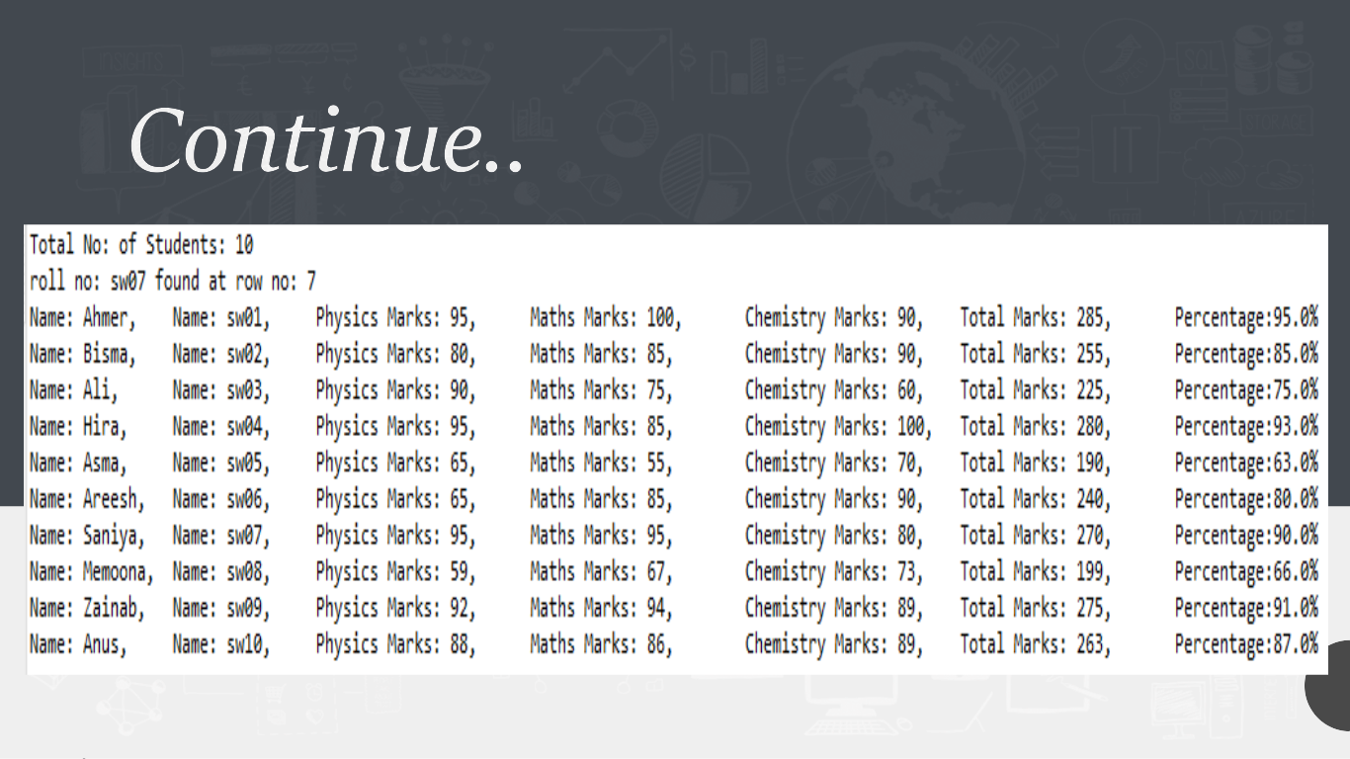
Title
Text
Notes:
After this I displayed the student records using for loop Like this.

Slide 9


